Slide 1
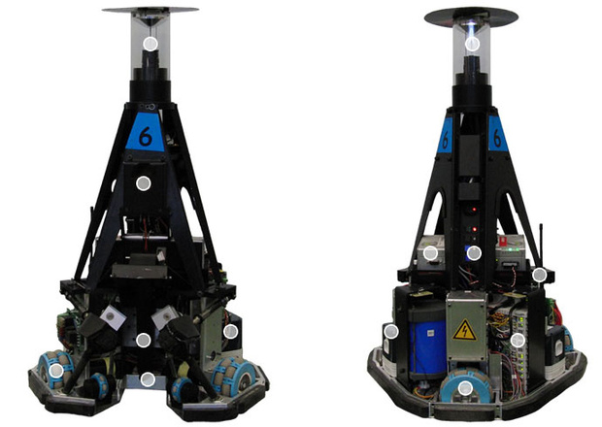


AutoRef Final Presention
2021 PDEng in Mechatronic System Design

Slide 3
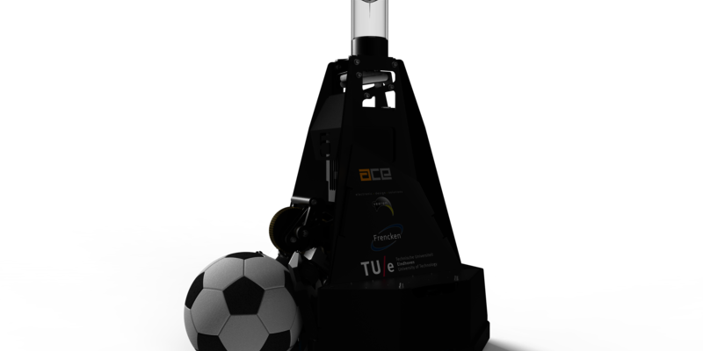
Table of Contents
01
02
03
04
Challenge & Solution
Purpose of the system, Scope, Deliverables and concern analysis
System Design
Tasks implemented and requirements
System Architecture
Functional Decomposition, Implementation and Integration
Integration and Validation
Code Implementation and Validation
Future work
05
Work recommendation to 2022 MSD team

Slide 4
01
Challenge and Solution

Slide 5
Challenge
AutoRef
Develop an autonomous referee to assist the human referee in a 2 against 2 robot soccer game.
Why?
Difficulty in performing some tasks by the human referee to detect rule violations

Slide 6
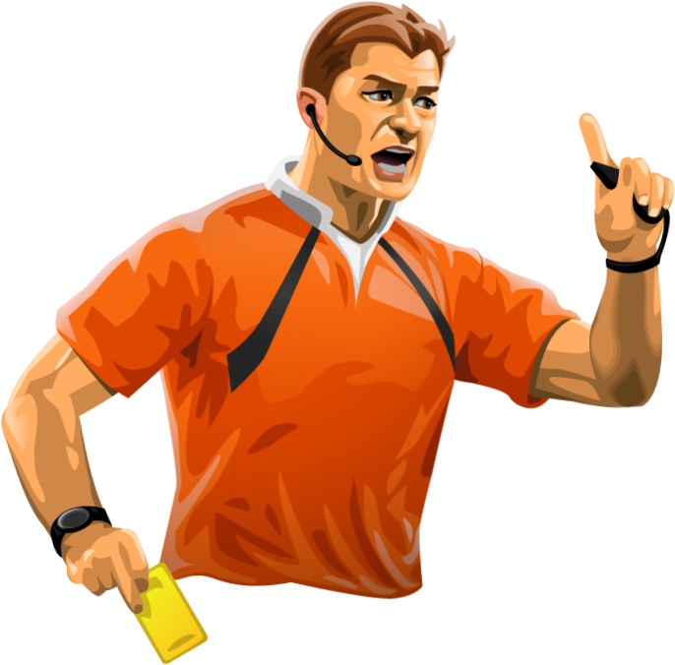


Understanding the Challenge
Different sources
Perception
Cognition
Communication
To relevant player/teams
Perception
Cognition
Communication
Gathering data from different perspectives of
the game.
Uses the knowledge of the rules and the information
received from the perception to make rule violations regarding the game.
Communicate the information regarding faults,
rule violations, etc to the human referee or the ref box and the robots involved in the game.

Slide 7
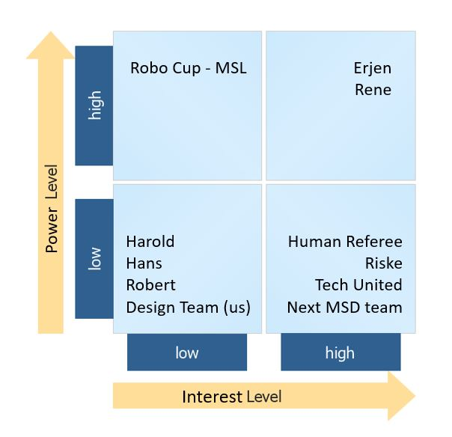
Stakeholder’s and concerns
Prof. dr. ir. Rene van de Molengraft
Structured and Systematic approach to the design of the AutoRef.
Extendability of the AutoRef in the future.
Prof. dr. ir. Erjen Lefeber as product owner
AutoRef to referee 5 mins match with 2 vs 2 turtle robots.
Prof. dr. ir. Erjen Lefeber as human referee
The loss of human referee’s job due to the AutoRef.
AutoRef should help the human referee in rules that are difficult for the human referee to interpret.
AutoRef should be developed and designed at the right abstraction level.
AutoRef should log and show the evidence for the called rule violations.
AutoRef to get positive feedback on its decisions from the human referee.
AutoRef should log and show the evidence for the called rule violations.

Slide 8
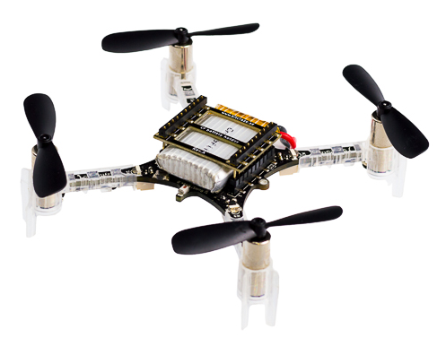
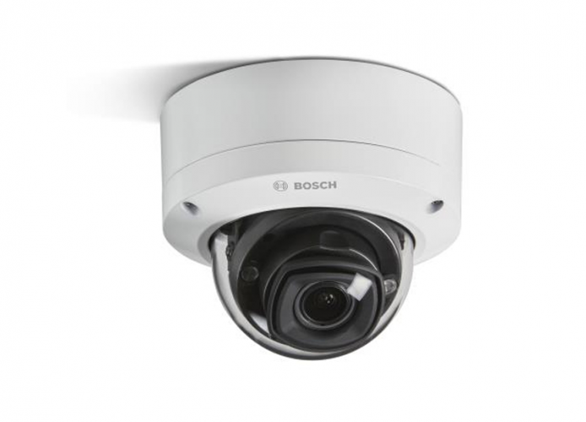
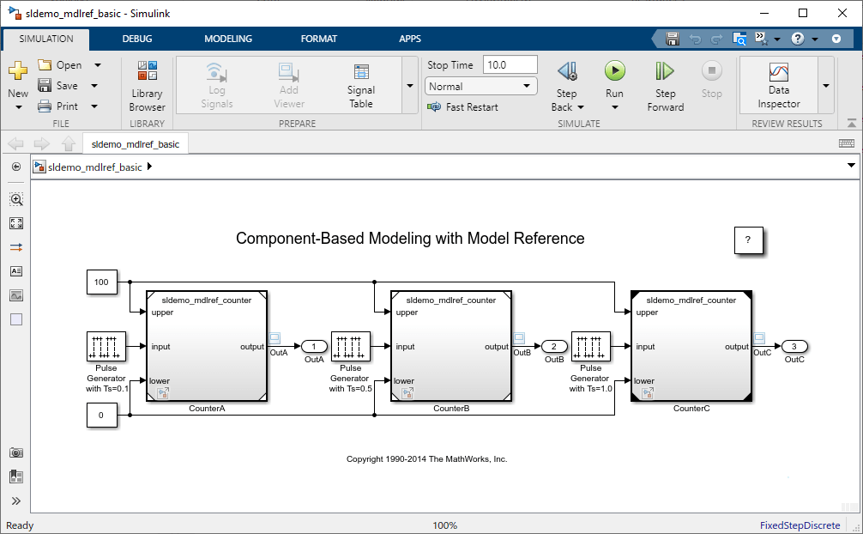
Feasibility Analysis for Data Acquisition
Drone + Camera
Stationary Cameras
TURTLES
2020 MSD Simulation
Recommended camera to use with the drone
Scenarios, number of drones required and flight altitude
Advantages/Disadvantages
User manual how to use the surveillance cameras of the Robotics lab.
How to process images using the cameras
Advantages/Disadvantages
How to install the Tech United software
Advantages/Disadvantages
Suggested improvements
Brief explanation about the simulation
Advantages/Disadvantages
Suggested improvements

Slide 9
Scope
Simulate a real match and store all data from all TURTLES in a .mat file
Data Model from the Tech United repository
Create offline decision-making algorithm to detect rule violations
Collect evidences for when the rules are violated
Where, when and who
TURTLES
Collect the data from the player to make decisions. One or more player could be used as a referee.
Why Turtles?
Reliable hardware and software
Contains all data available to create the decision-making algorithm
Easy interaction with experts (Tech United team)
Representation of a real robot soccer game
First step for a future implementation of an autonomous referee

Slide 10
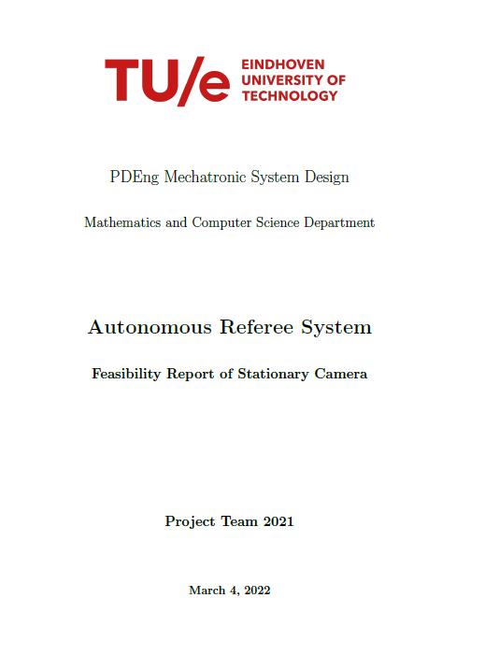
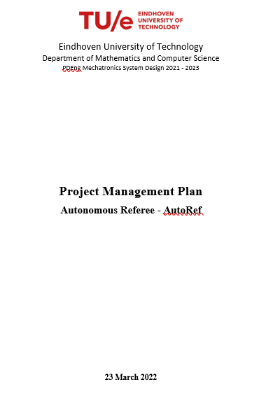
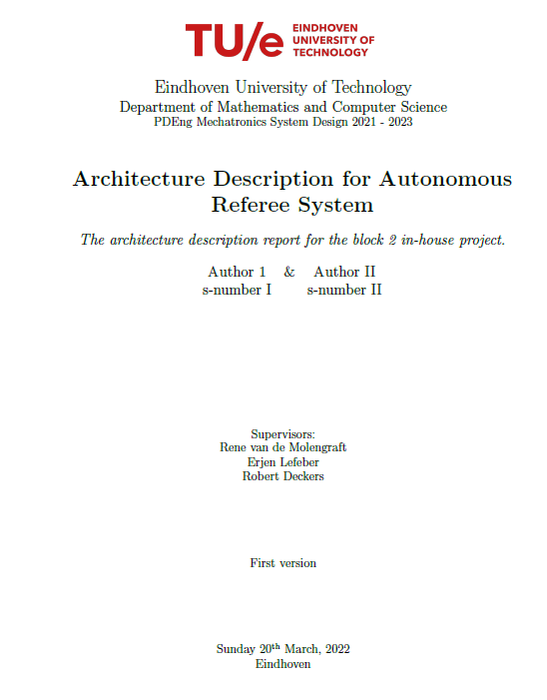
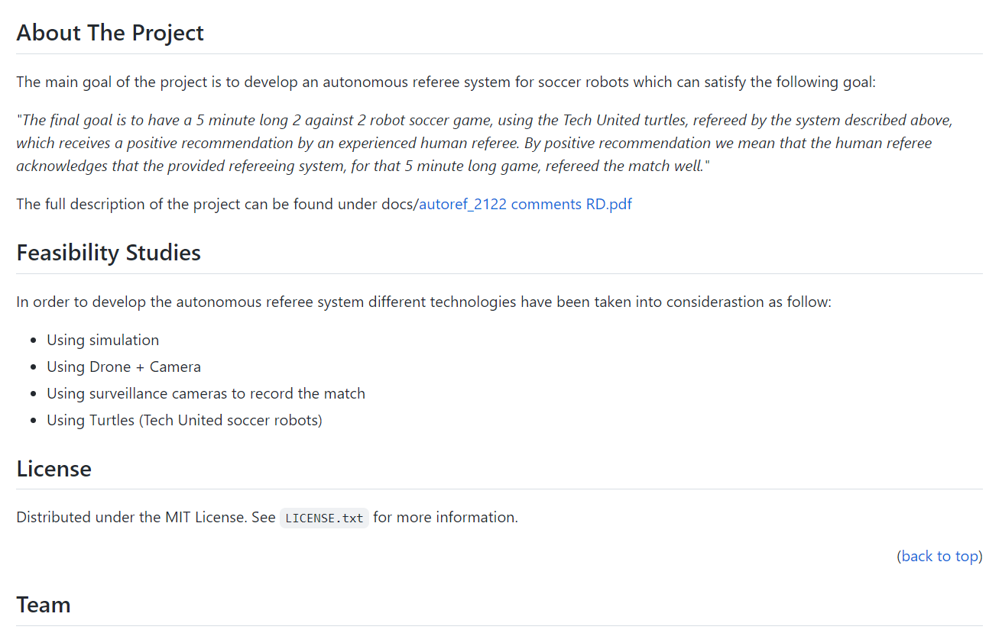
Scope-Deliverables
Project Management Plan
Feasibility report
PM framework
Project life cycle
Collect requirements
System Architecture plan
Design plan
Milestones
Work Breakdown Structure
Project Schedule
Risk Management Plan
Drone plus cameras
Stationary cameras
2020 MSD simulation improvement
TURTLES
Architecture Description
GitHub repository
Goals
Scope
Stakeholders concerns
Environment analysis
Model and views
Explanation of the project containing information about all deliverables
Explanations about the decisions taken
Future work recommendation

Slide 11
02
System Design

Slide 12
Laws & Tasks – Task1
9.1 – Ball Out of Play
The ball is out of play when:
It has wholly crossed the goal line or touch line whether on the ground or in the air.
Play has been stopped by the referee
Determine if the ball is in or out of pitch (BOOP)
Notes:
Mention identifying “last player touched”
Mention “award ball possession to”

Slide 13
Laws & Tasks – Task2
After the kick, the attacking team is only allowed to touch the ball a second time after it moved over a distance of at least 0.5m.
08.3 – Procedure (KICK – OFF)
15.1 – Procedure (THROW – IN)
16.1 – Procedure (GOAL KICK)
17.1 – Procedure (CORNER KICK)
13.4 – Position of the Free Kick (FREE KICKS)
Determine if the ball has rolled freely for >0.5 m after kick

Slide 14
Requirements
Sl No. | Req ID | Requirement | Task 1/2/Common
1 | ARS_001 | The AutoRef system shall use the following data for rule violation detections: • ballPos • fieldDimension • PlayerPos • ballVelocity • RefBoxCommand | Common
2 | ARS_002 | The AutoRef system shall derive the field coordinates from the field dimensions. | Common
3 | ARS_003 | The AutoRef system shall detect whether the ball has wholly crossed the goal line or touch line whether on the ground or in the air. | Task1
4 | ARS_004 | The AutRef system shall identify which field boundary line was crossed by the ball when it went out of the field. | Task1
5 | ARS_005 | The AutoRef system shall log the evidence for the time instance when the rule was violated in a defined format. | Common
6 | ARS_006 | The AutoRef system shall provide the signal to "Stop" the play for the following: • When ball has wholly crossed the goal line or touch line whether on the ground or in the air • When a rule is violated | Common
7 | ARS_007 | The AutoRef system shall provide the signal suggesting the Rule Violation when a rule is violated. | Common
8 | ARS_008 | The AutoRef system shall identify the last player who touched the ball before ball has wholly crossed the goal line or touch line. | Task1
9 | ARS_009 | The AutoRef system shall assign possession of the ball based on the last player who touched the ball before ball has wholly crossed the goal line or touch line and which field boundary line was crossed by the ball. | Task1
10 | ARS_010 | The AutoRef system shall identify the gameState based on the RefBoxCommand. | Task2
11 | ARS_011 | The AutoRef system shall detect the player ID to identify the player who is taking the kick and who is receiving the kick. | Task2
12 | ARS_012 | The AutoRef system shall check the distance for which the ball has rolled freely once the ball is kicked and the kick is received. | Task2
13 | ARS_013 | The AutoRef system shall indicate the rule has been violated if the distance for which the ball has rolled freely once the ball is kicked and the kick is received is less than 0.5 m for the following gameStates: • Kick Off • Corner Kick • Throw In • Goal Kick • Free Kick | Task2
14 | ARS_014 | The AutoRef system shall track the real time relative to the match time. | Common
15 | ARS_015 | The AutoRef system shall identify the rule violations within 500 ms of the actual rule violation | Common

Slide 15
03
System Architecture

Slide 16
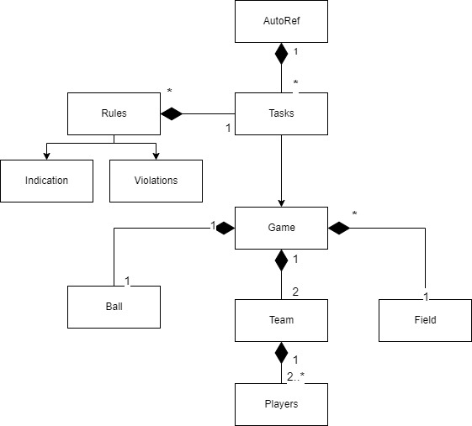
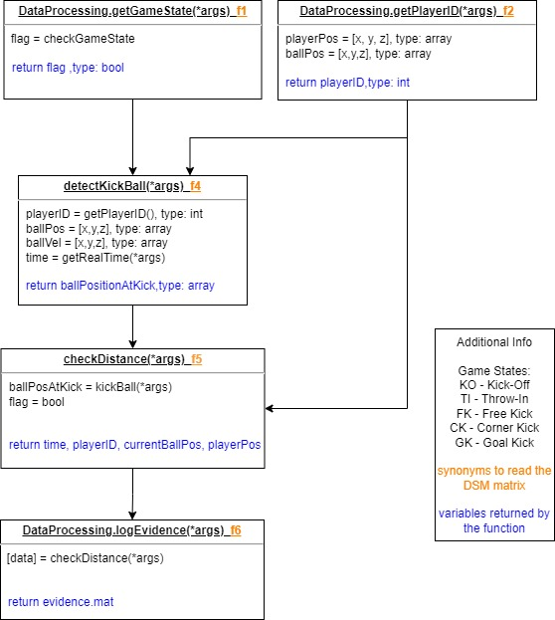
System Architecture
Notes:
Autoref has Tasks (functionalities), to perform task, we need data from the game. The game consists of 1 ball, 1 field, 2 teams of 2 players each. The tasks are aimed to check the rules. Indication says which rule is violated, and violations logs the data containing with respect to the game state.

Slide 17
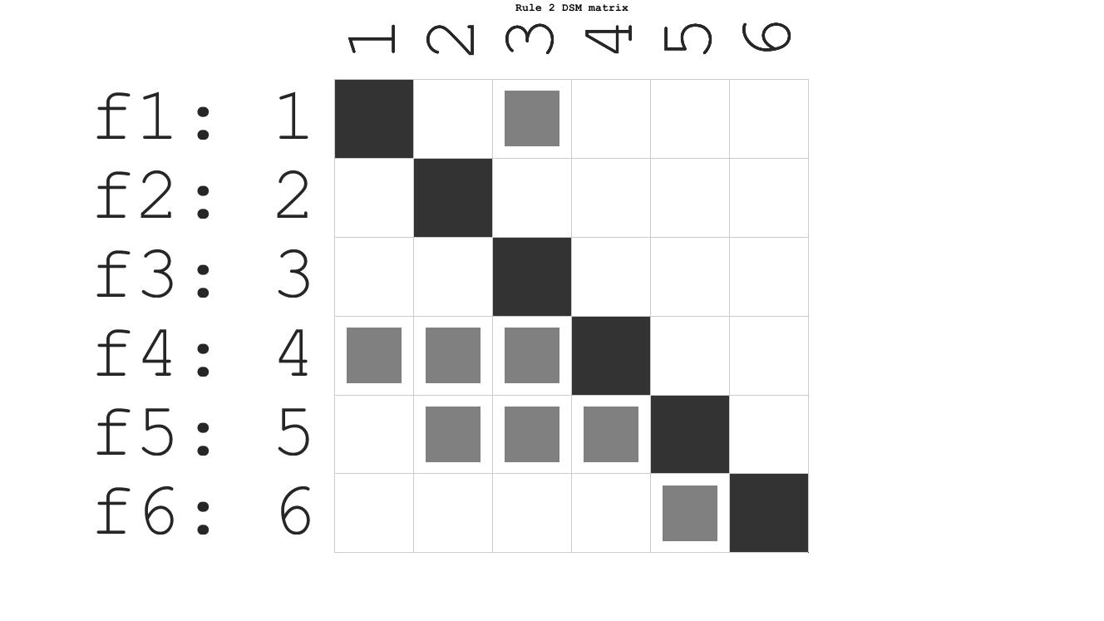
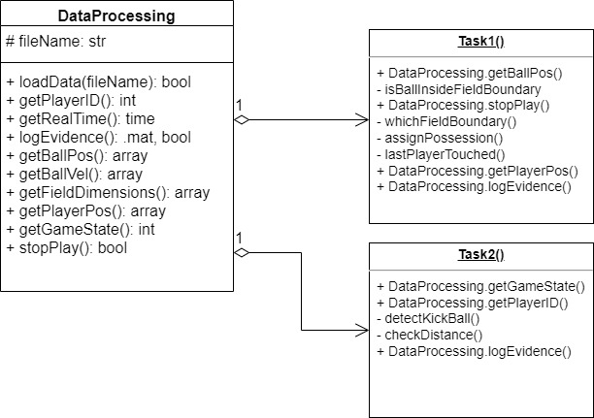
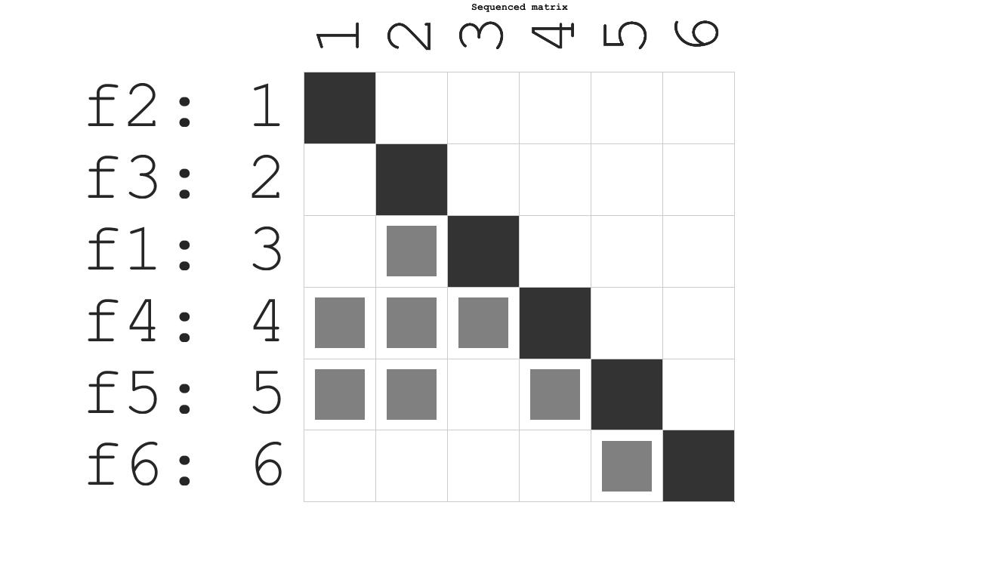
System Architecture

Slide 18
04
Integration and Validation

Slide 19
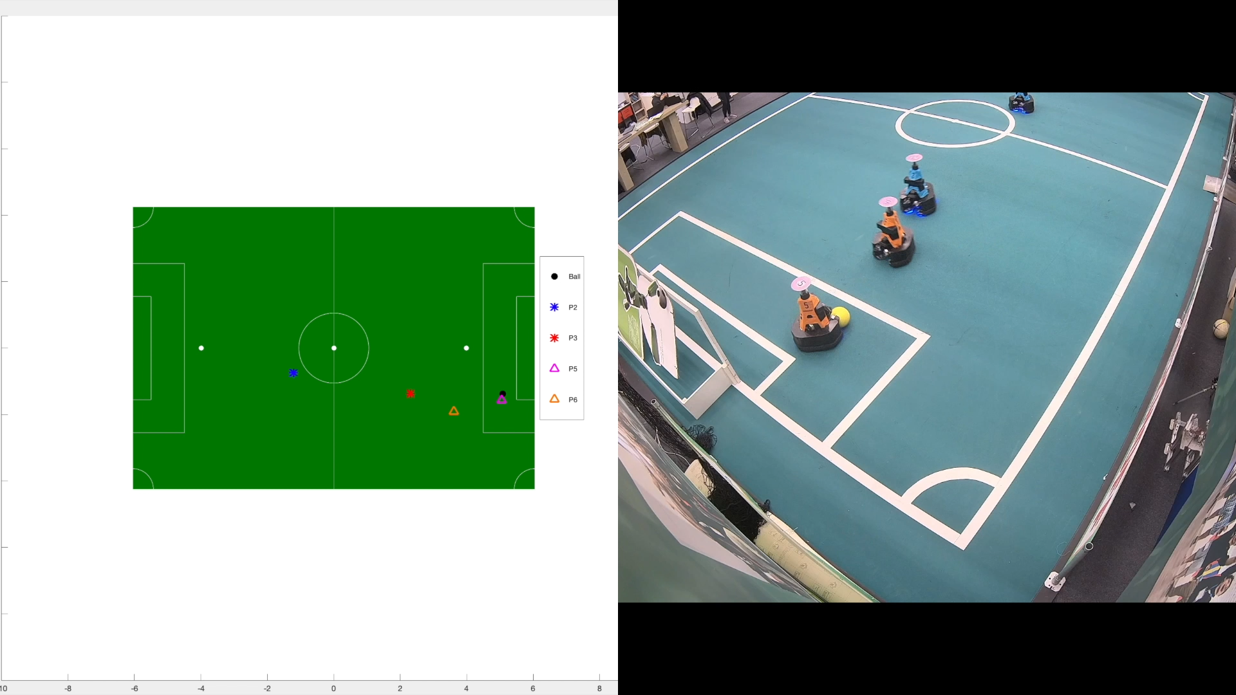
Integration & Validation – Task 1
Notes:
DSM helped us get started efficiently on design & integration
Successfully completed for two main tasks
Needed data to validate on real data
Spent a lot of time at Tech United field getting various match scenarios
As detailed previously, Task 1 identifies that the ball went out of bounds, and which player last touched
Video on right shows a scenario where blue player kicks ball out, hard to identify for human referee
Our algorithm correctly detects ball out and blue player last touched
Displays which boundary ball crossed, provides coordinate for throw in

Slide 20
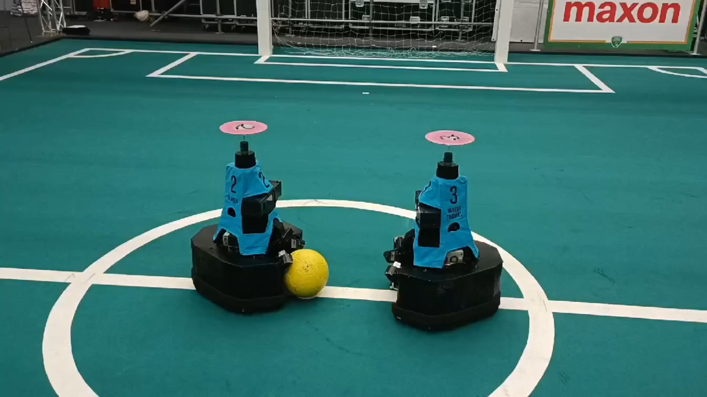
Violation Ball Roll < 0.5 m – Task 2

Slide 21
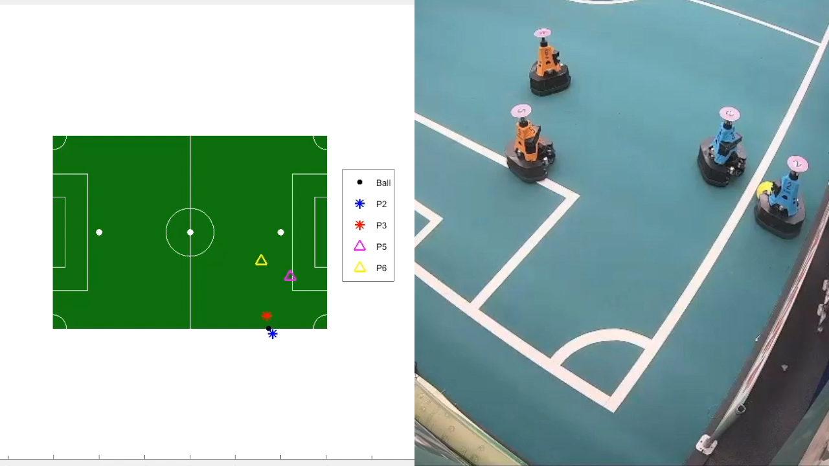
Integration & Validation – Task 2 (throw-in)

Slide 22
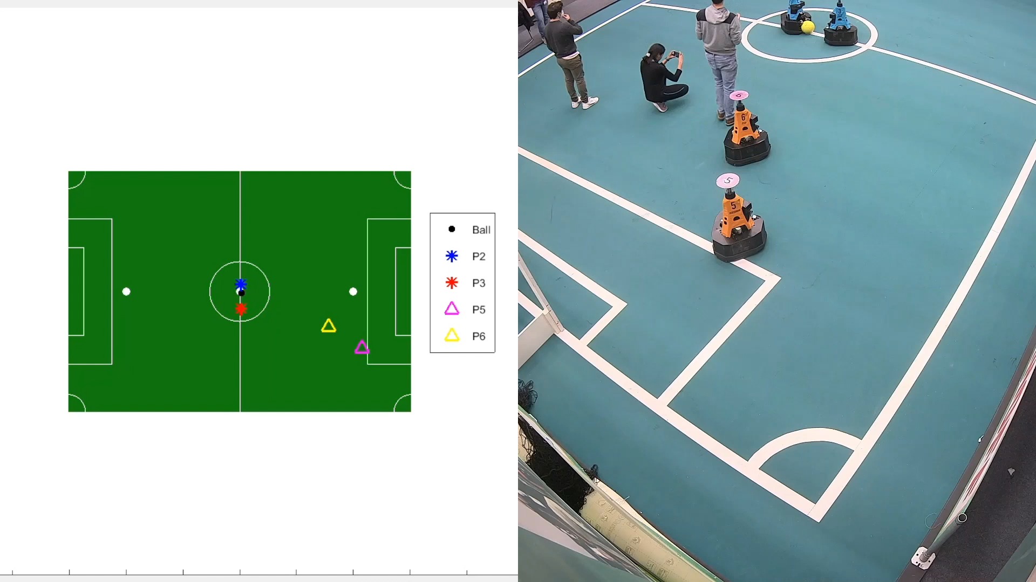
Integration & Validation – Task 2 (kick-off)

Slide 23
05
Future work

Slide 24
Future Work
Different sources
Perception
Cognition
Communication
To relevant player/teams
Cognition
Add new tasks to detect different rules violations
Detect violation in live (real-time) robot soccer match
Improve algorithm performance
Perception
Create the data using:
Stationary cameras
Drones and cameras
Use another robot as a referee to simulate a real soccer game to avoid bias
Communication
Implement communication between AutoRef and Refbox
Communicate awarded team decision
Real time communication with human referee
*Architecture Description contains the detailed explanation about Future Work recommendation
Notes:
Relating back to function of human referee in understanding the challenge
Three main thrusts for future work
Perception, Cognition, Communication
Derived from our System Architecture, which was built with the intent to allow impactful development to continue on individual sub-areas
We intend our documentation to provide quick and clear entry point for future teams
Reduce startup times
Allow focus on impactful contribution and learning goals

Slide 25
HAPPINESS

Slide 26
Thanks!
2021 MSD Team

Slide 27
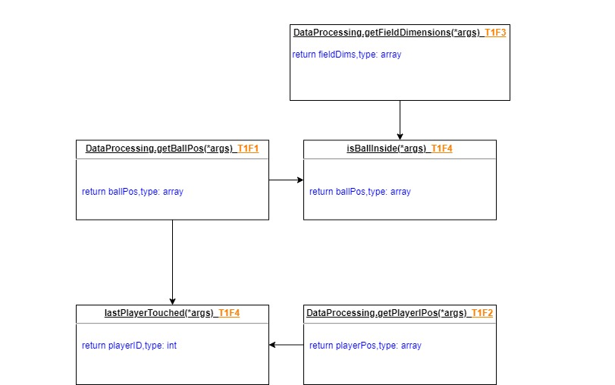
Task 1 decomposition

Slide 28
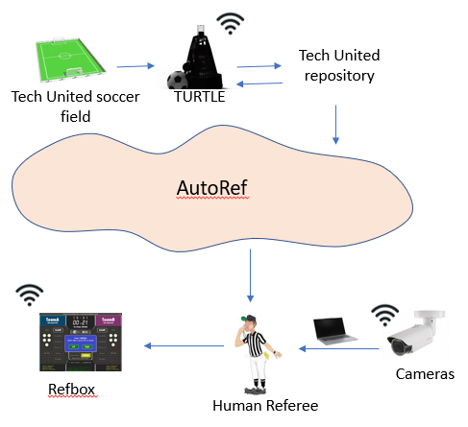
Environment Analysis
Notes:
Autoref has Tasks (functionalities), to perform task, we need data from the game. The game consists of 1 ball, 1 field, 2 teams of 2 players each. The tasks are aimed to check the rules. Indication says which rule is violated, and violations logs the data containing with respect to the game state.

Slide 29
Design-Decision
PUGH Matrix
Criteria | Improving last year Simulation | Drone + Camera | Stationary Camera | TURTLE
Ease of development(parallel and sequential) and testing | 0
Easy to achieve stakeholders Concern | 0
Easy to implement high number of rules | 0
Reliable(fairness, positive feedback) | 0
Ease of assembly | 0
Hard to bias the infractions | 0
Learning goals fulfillment | 0
Easy to create interface between components | 0
Easy to mantaing high level of Abstraction(or Autonomy) in the system (how deep we go into the system) | 0
Easy to create data collection and processing | 0
Reduced number of platforms, tools or programing languages used | 0
Total

Slide 30
Laws & Tasks – Task1
9.1 – Ball Out of Play
The ball is out of play when:
15 – Throw-In
A throw-in is awarded
It has wholly crossed the goal line or touch line whether on the ground or in the air.
Play has been stopped by the referee
when the whole of the ball passes over the touch line, either on the ground or in the air,
from the point where it crossed the touch line,
to the opponents of the player who last touched the ball.
Determine if the ball is in or out of pitch (BOOP)
Determine if the whole of the ball has passed over the touch line

